Slide 1

Mental Health First Aid
A Strathcona County Case Study
Jason Greidanus
Assistant Chief – Emergency Management
16 April, 2019

Slide 2
what we’ll cover
Introduction and disclaimer
Some definitions and concepts
Ways to deal with the trauma
Reducing the stigma
Organizational impacts
The County Case Study

Slide 3
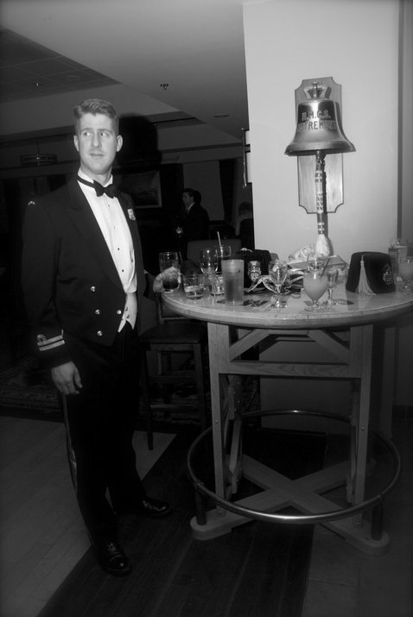
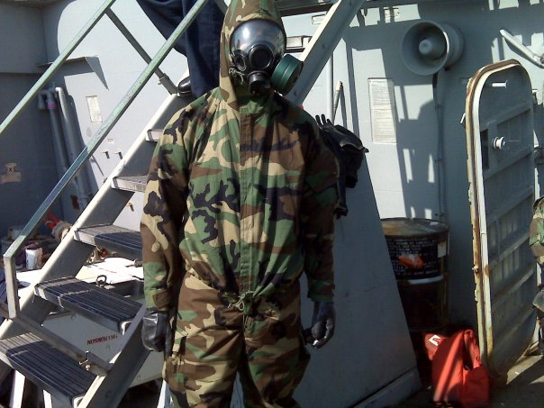
who am I?
Notes:
Assistant Chief & Deputy Director of EM for Strathcona County, a position held since 2015
Completed MADEM in October 2016, where the focus was on building resilience and strong communities
Physical and preparedness/readiness, as well as emotional and mental resilience
Psychosocial impacts of disaster course in May 2016, coincided with the wildfire in RWMB and my deployment there
Veteran of a 20 year career in the Royal Canadian Navy
Like many members of the CAF I’ve dealt firsthand with the impacts of operational stress injuries, both in myself and in peers. I was fortunate to get the help needed to overcome struggles with depression, but others still struggle years later, and others didn’t succeed in beating the effects of mental illness
Now as a member of a first responder community, and working a lot with people from industry and municipal governments, I find it is important to inform and educate about the impacts of mental illness and maintaining positive health in the face of stressful and demanding situations

Slide 4

who I’m not!
Notes:
Not a medical practitioner, licensed therapist, or promoting any particular organization.
This presentation grew out of a social media challenge I undertook in 2016, the 22 Push-ups in 22 Days challenge for Wounded Warriors Canada. Instead of just doing the push-ups and posting them to Facebook, I took a minute or so to explain aspects of PTSD, mental health, and regaining/maintaining positive mental health.
It’s also tied to course-work and research done during my MADEM, particularly the psycho-social impacts of disaster course taken in May 2016
This presentation was taken on in order to raise awareness of mental health impacts among responders. I encourage you to take this awareness, reach out to the appropriate programs and professionals, and to continue to learn more on how to maintain positive mental health

Slide 5
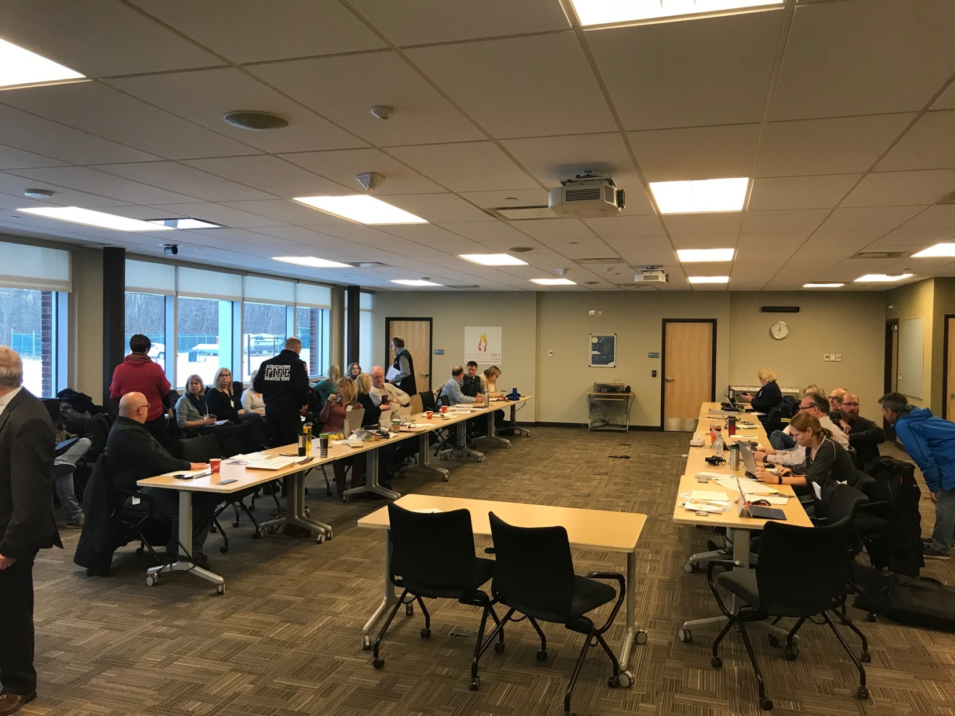
what are we talking about?
Notes:
Definition of critical incident stress, operational stress injury,
Critical incident stress – a condition caused by acute stress which overwhelms someone trained to deal with critical incidents such as within the line of duty for first responders, EMTs, and other related personnel.
Operational stress – chronic stress and persistent psychological difficulty arising from operational duties performed while serving in the CAF or RCMP. Difficulties may occur during combat duties, after serving in a war zone, in peacekeeping missions, or following other traumatic or serious events not specific to combat.
What is a traumatic event? If the person experienced or was confronted with an event that involved actual or threatened death, serious injury, or the physical integrity of themselves or others. The person’s response must have also involved intense fear, helplessness, or horror.
PTSD – a mental illness that often stems from exposure to traumatic stimuli from single or repeated events that involve death or threat of death.
Note that the official definitions all focus on first responders, police, military or similar professions that are trained to deal with exposure, expect such events, and have more supports to deal with such events.
These are called primary responders
Emerging research around secondary responders, such as those municipal employees, utility workers, and volunteers who find themselves involved in response activities without the training, expectation of risk, or supports.
While PTSD is only expected to affect around 10% of the population, this group is at a higher risk of developing issues associated with PTSD

Slide 6
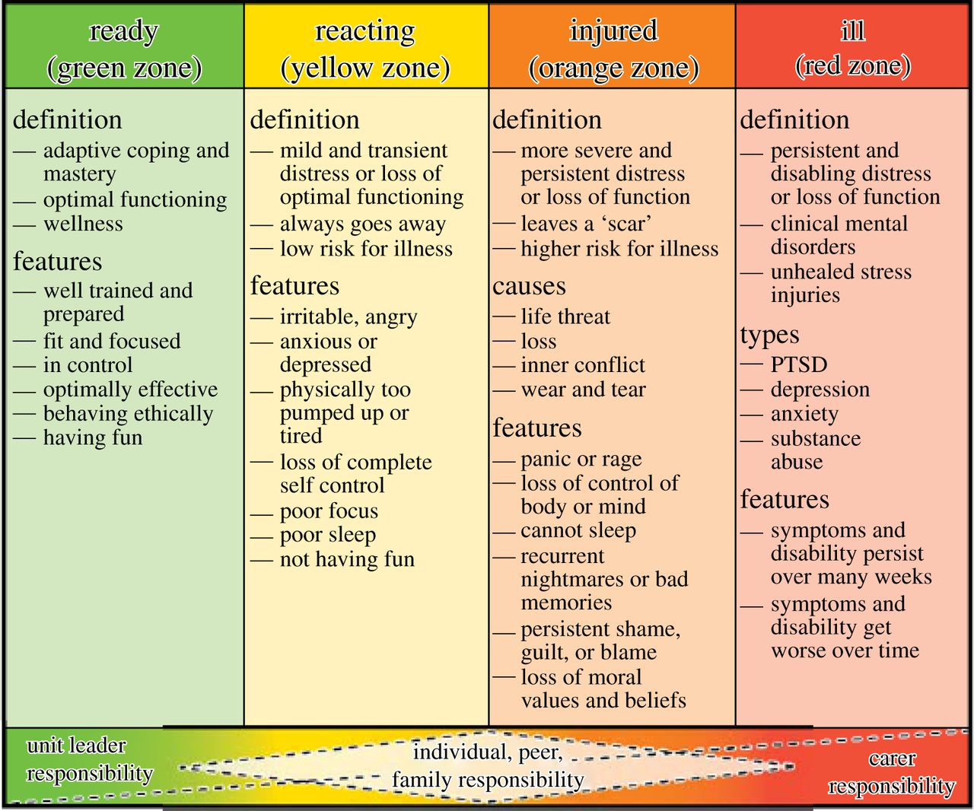
the injury spectrum
Notes:
Lots of attention on PTSD in the media, but its led to some misunderstanding around it and mental health in general.
Intensity of symptoms can vary quite a bit, as does duration of those symptoms, because traumatic stimuli and our responses to them as individuals is different.
They can last for days, weeks, or even months, and about half of those suffering with the symptoms will recover from them within 1-2 years without any intervention.
This is normal, and often are ways that our mind and body deal with the traumatic stimuli in our own way, much like how we do with stress, grief, or other things in life.
PTSD happens when those normal healing mechanisms don’t work any more.
Unfortunately the other half can have the symptoms that don’t get better; AND STATS SUGGEST A THIRD OF THOSE MAY EXPERIENCE THAT THEIR SYMPTOMS BECOME WORSE / MALADAPTIVE.
The key is to not wait for treatment or getting help. Peer support or CISM can take place right away, and you can do things to help alleviate the injury. For a formal diagnosis and care you need symptoms for greater than one month, but that’s not to suggest doing nothing until 30 days are up.
Traumatic event does not equal PTSD! PTSD is the maladaptive outcome of CIS/OSI / CHRONIC STRESS left untreated.
Spectrum of critical incident stress injuries/operational stress injuries

Slide 7
value yourself
mind your body
give of yourself
calm your mind
the right people
make a plan
take a break
break addictions
know when to get help
Notes:
Value yourself
– even though it’s difficult due to the symptoms such as depression or loss of interest, when you’re depressed or suffering from OSI/PTSD, treat yourself with kindness
Avoid self-criticism
Make time for hobbies and projects
Self improvement such as learning a language or taking up an instrument can provide focus away from the traumatic event and also help improve your self-worth
Mind your body
Eat nutritious meals
Avoid or reduce damaging habits like drinking, drugs, or alcohol
Drink plenty of water
Exercise! Huge mental health benefits as well as physical. Helps to reduce depression, anxiety, and improve mood
Sleep. Many signs that lack of sleep compounds mental health issues, and leads to spiralling conditions
BE AWARE OF HOW YOUR BODY IS FEELING AND REACTING (MIND-BODY CONNECTION)
Give of yourself
Volunteering your time and energy to help someone else is a great way to improve your self worth, as well as helping those in need and improving your social network and connectedness
Calming your mind
Can be done in many ways, such as yoga, tai chi, meditation, relaxation exercises, or just taking a walk or being in nature
Connectedness and calm can come from finding and improving faith. Often faith suffers when trauma happens, but it can also be a source of strength and peace
Learning to deal with stress and techniques for calming your mind will help when there’s emotional and mental turmoil, and help you turn off the traumatic “movie” playing in your mind
Have the right people in your life
Having strong family and friend networks help keep us feeling connectedness, which is critical when working to maintain or improve mental health
Supportive family and friends can help with finding helpful activities, maintaining a high self worth, and can give help when you need it most
Make a plan, stick to it!
We’ve talked a lot about taking on projects, self improvement, and building your social support network, but remember to make a plan and stick to it
Write down the steps you need to accomplish to realize your goal and a timeline for achieving it
Push yourself, but keep it realistic and achievable, and don’t overschedule or set yourself up for failure
Take a break
Having and sticking to a routine is very important, after big events like Fort McMurray many responders and evacuees alike said they just wanted to get back to their normal routine
Making the lists of goals and a plan to accomplish them provides structure which can also be helpful
Also remember to schedule in time to take a break and change the routine, it can be helpful to change a perspective or ensure you take time to value yourself
Break addictions
Most people associate addictions with alcohol, drugs, or tobacco, but it can also include gambling, online gaming, or other behaviours that have a detrimental effect on you and your loved ones
Cravings, inability to abstain, not being able to control your engagement, and reduced sense of satisfaction with the activity are all signs that the behaviour is harmful
Addictive behaviours can be used to mask symptoms or to self-medicate, but will only make things more difficult to deal with
All of these things can have a detrimental effect on sleep, appetite, motivation, relationships, and health
Abstinence is ideal but, realistically, unlikely. Moderation is important, but if you or a loved one are dealing with this then there is help out there
Know when to get help
If you or a loved one has concerns about mental health the answer is yes
If any of the things I’ve talked about resonate with you, the answer is yes
If you have been exposed to a traumatic event but don’t think you’re affected, the answer is yes
If you ask yourself “perhaps I need help, should I get it?” the answer is yes
Even if asking for help is mentioning it to your family doctor, loved one, or just looking online for more information. It doesn’t have to be an intervention, big production, or full treatment, it just has to be one simple step. If it’s just a matter of noticing that someone around you might not be quite right, asking the question if they’re doing ok.

Slide 8

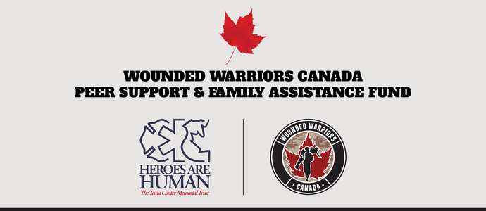
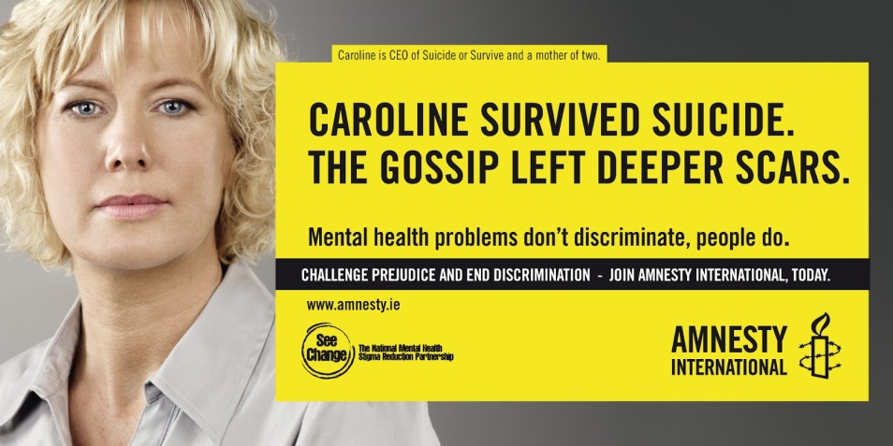


reducing stigma
Notes:
Individual
Peer
Leadership
As an individual, know your strengths and weaknesses, and most importantly know when something is wrong and getting help when you need it
Be a supportive co-worker by modeling positive mental health behaviours and attitudes, and helping your peers when they may be struggling
Educate co-workers, challenge conventional beliefs, and hold peers to a higher standard of behaviour
Don’t label people with mental illness, a person is a person, not a diagnosis. The mental illness doesn’t define the person, in the same way any other illness defines that person
Don’t blame people with mental illness, it’s not their fault nor did they choose it for yourself
Don’t be insensitive with people with mental illness, don’t tell them to “suck it up” or “get over it”
Be a role model and a positive example of appropriate behaviours and attitudes towards mental illness
Through your own words and behaviours
By not accepting it from your peers and subordinates
By creating a space where there is promotion of all facets of healthy lifestyle
Ultimately it’s your responsibility to help create a culture that reduces stigma and helps the people around you to recovery

Slide 9
organizational symptoms
Breakdown in communication, trust, productivity
Workers feel powerless, hopeless
Turnover in roles and responsibilities
Absenteeism, increased health costs, substance abuse, emotional outbursts
Notes:
An organizational trauma, such as what we saw with the Fort McMurray fires at the one extreme end, but also through persistent economic uncertainty, downsizing, restructuring, etc. Trauma can also be induced through a poisonous work environment, poor leadership, or interpersonal stress that spills over in the workplace. Workplace violence or events in the facility, even fire, flood, or other disaster can induce a sense of loss and uncertainty that, if persistent or prominent enough, can lead to a sense of trauma in the staff.
Some of the symptoms of this type of organizational trauma include:
- a breakdown in communication, trust, or productivity. Quite often legal or corporate requirements, or a lack of information leads to a lack of communication. This allows an information vacuum that leads to rumours and other misinformation. Without a real narrative, this narrative can take over and cause further anxiety or stress. As long as leadership doesn’t address this head-on, it can have an effect on productivity as people who are nervous and insecure won’t be motivated to achieve high results.
Quite often the events that take place are out of the control of the majority of the staff, so that can lead to a sense of powerlessness and hopelessness. This too can compound the breakdown in trust and communication that takes place.
Organizational changes that may result from an incident, such as moving to temporary facilities, taking on additional roles, or losing an important part of the daily routine can be an additional stressor.
The result is that there can be an addition increase in absenteeism, increased demands on the health plan as people seek additional medical help with the physical and mental impacts. If your organization doesn’t have a strong health plan or there’s a stigma around accessing it, it can lead to self-medicating through alcohol, drugs, or other escapism behaviour such as gambling or online gaming. Addictions can further stress an organization and families, leading to a spiraling situation, emotional outbursts, and higher staff turnover. A vicious circle emerges.

Slide 10
organizational strategies
Develop a representative group for peer support
Information and education – reduce stigma!
Get prepared – emergency plans and exercises
Strong Employee & Family Assistance Program
Strong leadership (including in HR)
Keep in touch
Keep track of claims & compensation – lagging indicator
Notes:
So what can be done? Is it all doom and gloom? No! Quite the opposite. Like individual resilience that can be built up at a personal level, organizations can do things to help relieve this stress before, during, and after a traumatic event.
In no particular order, and with no emphasis on one over the other. All of the strategies can be employed, much like the list above for individual strategies. The goal is to find a balance in this and develop a program that’s right for you and your organization.
Develop a representative group for peer support. It’s not something that leadership can develop for you, nor should it exclude senior management. Everyone has a part, and the goal is to bring together a peer support team that balances the resources, communication, people, and techniques effectively.
Information and education is key. Reducing stigma and creating a healthy environment where mental health can be dealt with properly comes from having the right information and sharing it freely.
Get prepared. Having an awareness of the hazards that exist for your organization, developing response plans, and then practicing them in a safe way can be seen as an inoculation to the trauma. By having a well trained, knowledgeable staff during an incident can reduce the sense of helplessness and powerlessness that may come if people aren’t prepared. That’s not to say you should create an environment that focuses on the negative and dwells on what bad could happen, but instead at least embracing it and doing little things to help prepare the team.
Having a strong and accessible EFAP – and the confidence to use it anonymously or without fear of recrimination. Stigma!
Strong leadership, not just in management, but at all levels, that are willing to champion the mental health program within the organization.
Maintain connections and keep in touch. Having small ways to keep the teams connected, especially if they’re separated by geography or function within the organization. Just like in your personal life, having strong connections to your peers helps foster a sense of trust that will help keep the organization strong.
Quite often a lagging indicator is health and compensation claims. Keep your attention on the trends after an incident, normally there will be a sharp increase followed by a tapering off as the people heal and cope. If you see the trends going up and staying up, there may be a problem that needs to be addressed.

Slide 11

the County Case Study
Notes:
So in order to put it into context, I’ll move on to a brief case study.
Keep in mind that I’m unable to go into a lot of detail about the incident itself, and the associated police investigation, I can talk about some of the things the County did to deal with the situation that took place at the County Hall/Community Center on November 6, 2018.
On that night there was an explosion that took place on the second level of the parkade which caused a fire and the destruction of a number of vehicles on that level. The sole perpetrator was fatally injured and later succumbed to his injuries. The building was evacuated and there were no other injuries.
While damage was extensive, with smoke, soot, and debris throughout the building, the damage was light considering what took place.
Of note, the County’s Emergency Operations Center is in the basement of County Hall, requiring us to establish a secondary EOC at Fire Station #6.
About 90 County staff, most of them trained and experienced in the EOC, helped provide support to the response, recovery, and business continuity planning across the County.
The EOC was stood up for approximately 10 days, and the approximately 600 displaced staff were found temporary homes or workarounds to continue the important services that the County provides its citizens.
While the Library and Parkade are still closed for the foreseeable future as remediation continues to take place, the CH/CC facilities have been coming back online and staff returning to their normal offices and routines.

Slide 12
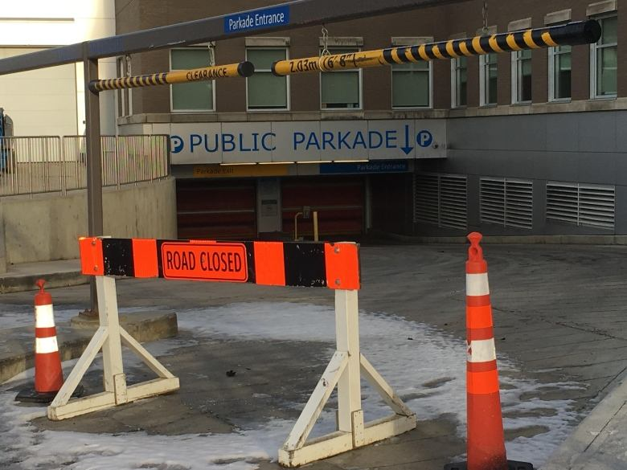
what was done
Notes:
Allowing for support and emotional health to have a place
Prior to the event, regularly held Mental Health First Aid sessions/courses open to all county staff
SCES Peer Support expanded to all of county staff
Sessions at Heartland Alliance
Support staff at key milestones and welcoming staff at the first day of re-entry.
EFAP through Morneau Shepell
Discussed the impacts on mental health and how we approached ensuring that staff had the appropriate supports to promote positive mental health.
Emphasized early intervention prevents later impacts, such as employee turnover, stress, absenteeism, substance abuse, and other negative impacts in the workplace.
Talked about how SCES Peer Support was expanded to the whole county, with help from Leduc.
Of course this all took place concurrently with the emphasis on safety of those visiting or working in the space. Remediation was done with the long term view of health of those in the space, as well as for future renovations etc.

Slide 13

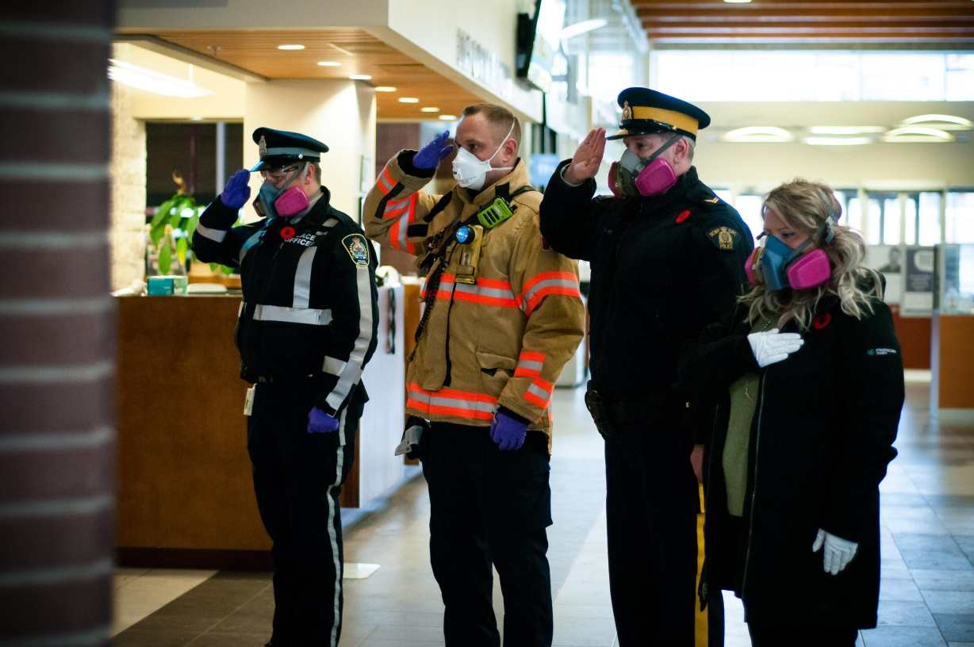
regaining normal
Notes:
Regaining sense of normalcy
One of the key areas where we focused our attention was around regaining a sense of “normal”.
The CC/CH facility is very much a centerpiece of not only the community as a whole, but also for the staff that work there.
A lot of our efforts in the response and recovery planning was to signal that we were still “open for business”
Most of these activities focused on providing those key services in alternate way, such as utility bills, building permits, and other key functions that the County provides.
Some of the other efforts centered around functions like the Library, which provides not only books and materials, but is also part of the social fabric of the county and provides key social connections.
Family & Community Services was likewise similar in that they wanted to keep up the important social services they provide, but also provide comfort and care in light of the shock to the community from this event, so doubly responsive.
But also some little things were done to signal that we intended to carry on as normal. This picture shows the County’s Fallen Heroes memorial in the CC facility. On Remembrance Day our contingent of fire, police, peace officers, and civilians performed their traditional memorial at the site. As you can see they used PPE but otherwise did things as they normally would.

Slide 14
where to go from here?
Canadian Mental Health Association
  edmonton.cmha.ca
Alberta Health Services (Addiction & Mental Health)
  www.albertahealthservices.ca/amh/amh.aspx
Canadian Psychological Association
  http://www.cpa.ca/aboutcpa/cpasections/
PTSD Association of Canada
  http://www.ptsdassociation.com/coping-strategies-1/
Your family doctor
The Employee Assistance Program with your company
Someone you know and trust
211 in Edmonton region
911
Notes:
Don’t rely on google or WebMD,
If you are going to do research online, at least visit some sites that have accurate and appropriate information
If you feel like you or someone you know desperately needs help and may be in trouble, don’t hesitate to call 911.
- ALSO WITH ALBERTA HEALTH SERVICES: HAS COMMUNITY CARE ACCESS (24/7 HELP LINE AND CONNECTION TO MENTAL HEALTH / PTSD SUPPORT) http://www.albertahealthservices.ca/info/service.aspx?id=1001464

Slide 15
mental illness is nothing to be ashamed of, but stigma and bias shame us all
Notes:
Quote from Bill Clinton
The key to overcoming stigma and bias is through learning and understanding. Learning about the impacts of mental illness brought on by traumatic events, and understanding what that does to ourselves and those around us. Mental illness strikes one in five Canadians, and that number only goes up with primary and secondary responders. It’s up to us to know about the nature of this illness and to hit back at it where it is most vulnerable, in ignorance and stigma. Working together we can create an environment where knowledge, understanding, empathy, and support help in healing mental illnesses and supporting positive mental health.

Slide 16
references
Canadian Mental Health Association
  edmonton.cmha.ca
Alberta Health Services (Addiction & Mental Health)
  www.albertahealthservices.ca/amh/amh.aspx
Canadian Psychological Association
  http://www.cpa.ca/aboutcpa/cpasections/
University of Michigan Health Services
  https://www.uhs.umich.edu/tenthings
Wounded Warrior – 22 Pushup Challenge – July/August 2016

